Slide 1
Prediction of Restaurant Closure- Helping businesses to survive
By-
Arpit Singh
Priya Sharma
Rishabh Agarwal

Slide 2
Introduction
Restaurant Business : $709Billion > more than GDP of 150 countries
27% of Restaurants fail in their first year
50% of Restaurants are not longer in business after 3 years
Hardly any studies from DS perspective to study failure
Used Yelp Data to build Prediction Model for Restaurant Closure

Slide 3
Pipeline of helping business to survive
Risk Analysis Model
Model helps predict the duration remaining before business closure
Feature Selection using regression
Survival Information
Text Analysis
(reviews)
Survival Engine
Provide Information to help businesses
Regression
Classifier Used:
Logistic Regression
SVM Classifier
Random Forest
K-NN Classifier
Bernoulli Classifier
Gaussian Classifier
Multinomial Classifier
Features
Time left
before closure
Binary
Classification
Business Health
Time based
multiclass Classification
Selection of ML model
5 fold cross validation
Aggregated over period of 6 months / years to predict the time of closure

Slide 4
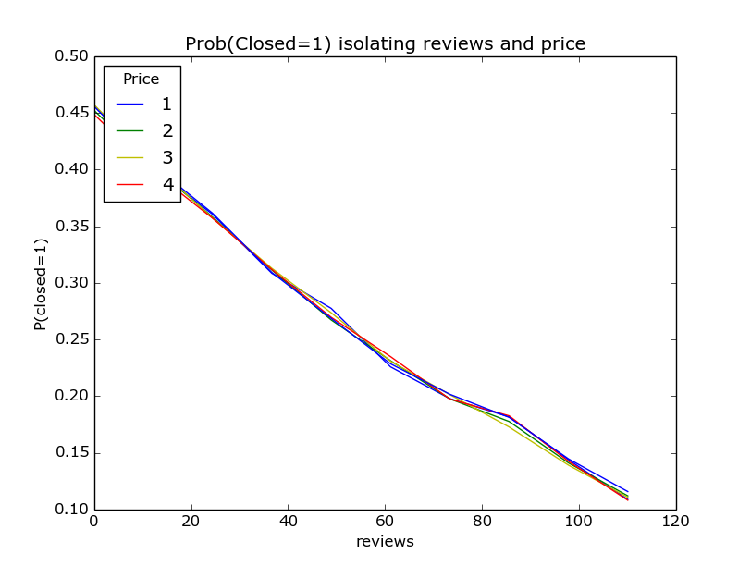
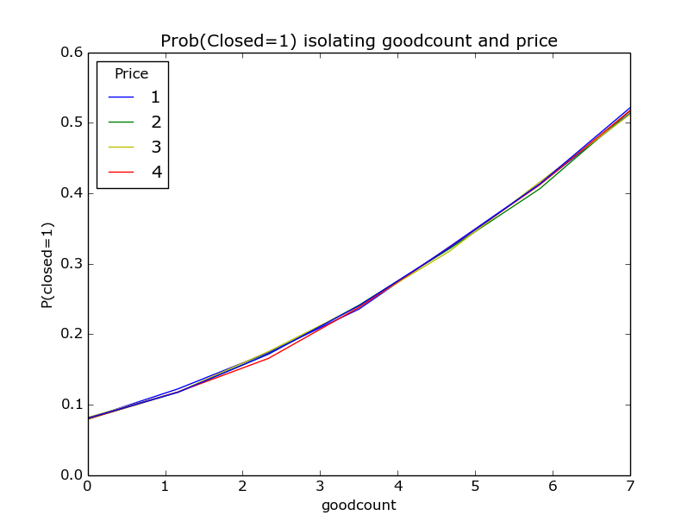
Correlation Results using Logistic regression

Slide 5
Outcomes of Prediction models
Classifier | Accuracy | ROC
Logistic Regression | 80.42% | .61
Bernoulli Classifier | 78.27% | .52
Gaussian Classifier | 74.65% | .56
Multinomial Classifier | 48.97% | .48
K-NN Classifier | 77.48% | .58
Random Forest Classifier | 78.49% | .58
SVM Classifier | 80.57% | 0.57
Cross Validation Folds | Multifold accuracy for SVM classifier
1st fold | 80.32%
2nd fold | 80.17%
3rd fold | 79.65%
4th fold | 80.84%
5th fold | 80.01%
Accuracy | 80.20%

Slide 6
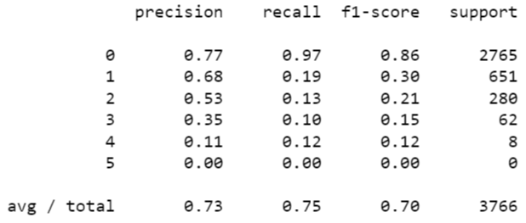
Time Series Analysis
Multi-Class Classification Results Classification Report for each Class
Metrics | Results
Number of samples in training data | 15072
Number of samples in test data | 3766
Number of correct predicted test samples | 2846
Accuracy | 75.49%
Recall score | 0.7549
Precision Score | 0.7262

Slide 7
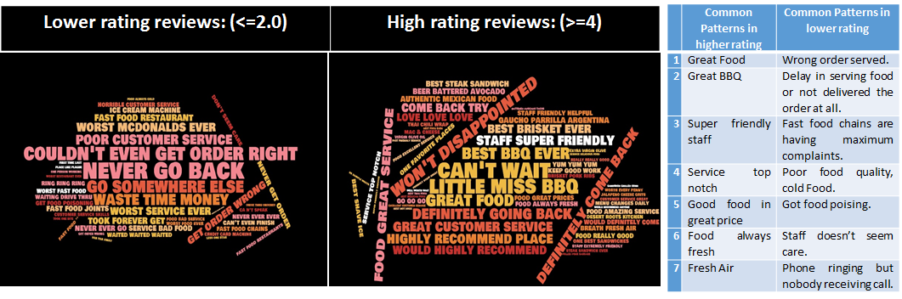
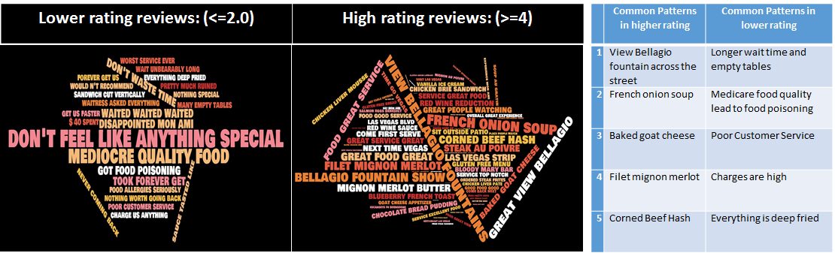
Textual Analysis
General Trends
Specific Trends

Slide 8
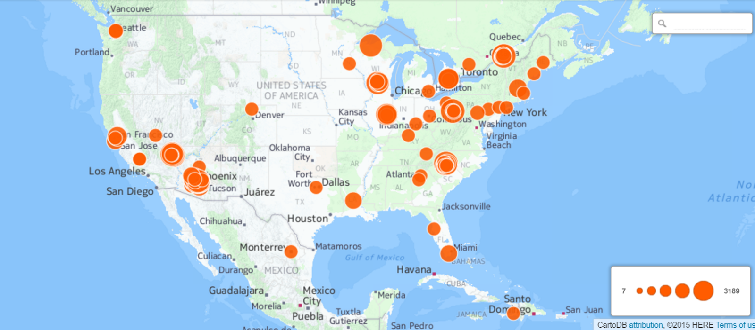
Location Analysis of Open Restaurants

Slide 9
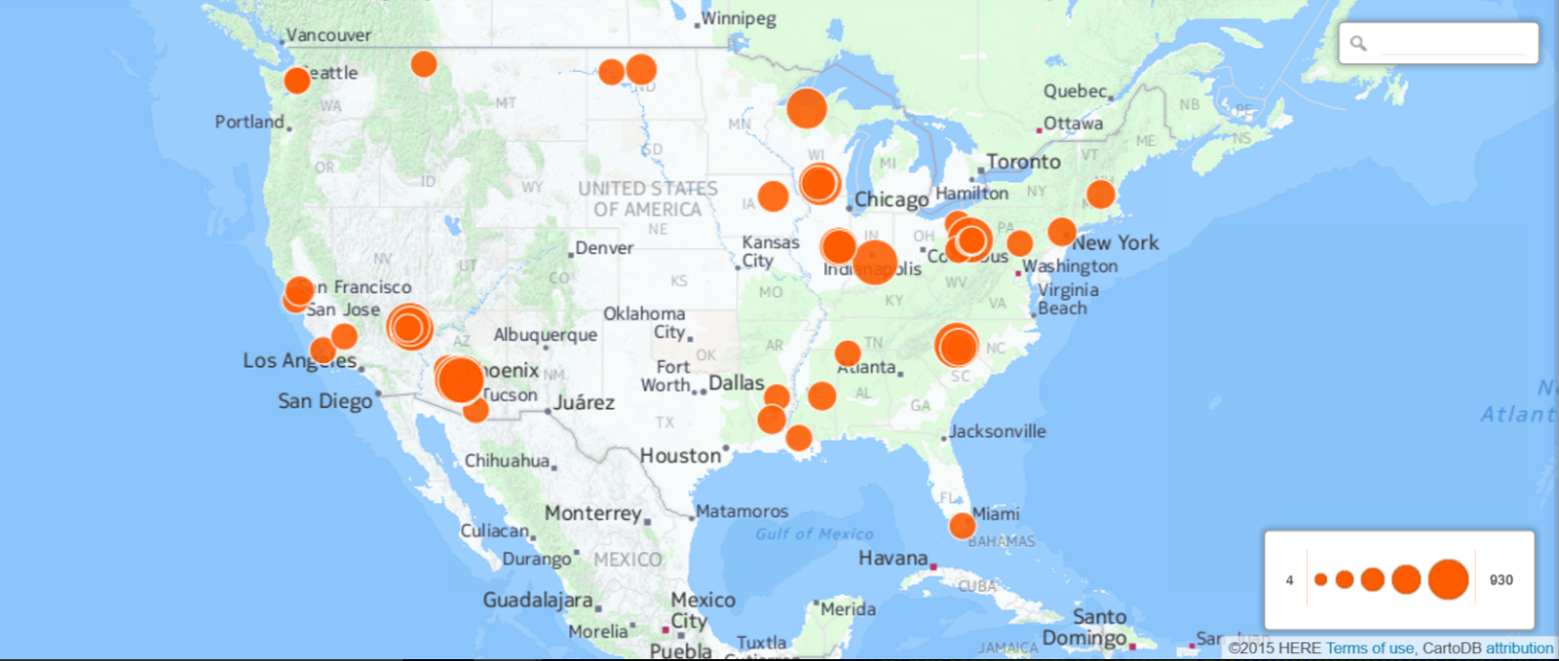
Location analysis of Closed Restaurants

Slide 10
Conclusion
We have done Textual analysis, location based analysis, time series classification and Feature based prediction of restaurant closure
Achieved accuracy of average 80% in SVM and naive bayes based classifier
The work can be extended by including more complex features taken from multiple tables
Our prediction engine can be converted to feedback engine for restaurants to determine their well being in market

